Slide 1
Analysis of AlphaFold2 Predictions for MPOX-22 Proteins
Devon J. Boland
Norman Borlaug Endowed Research Scholar

Slide 2
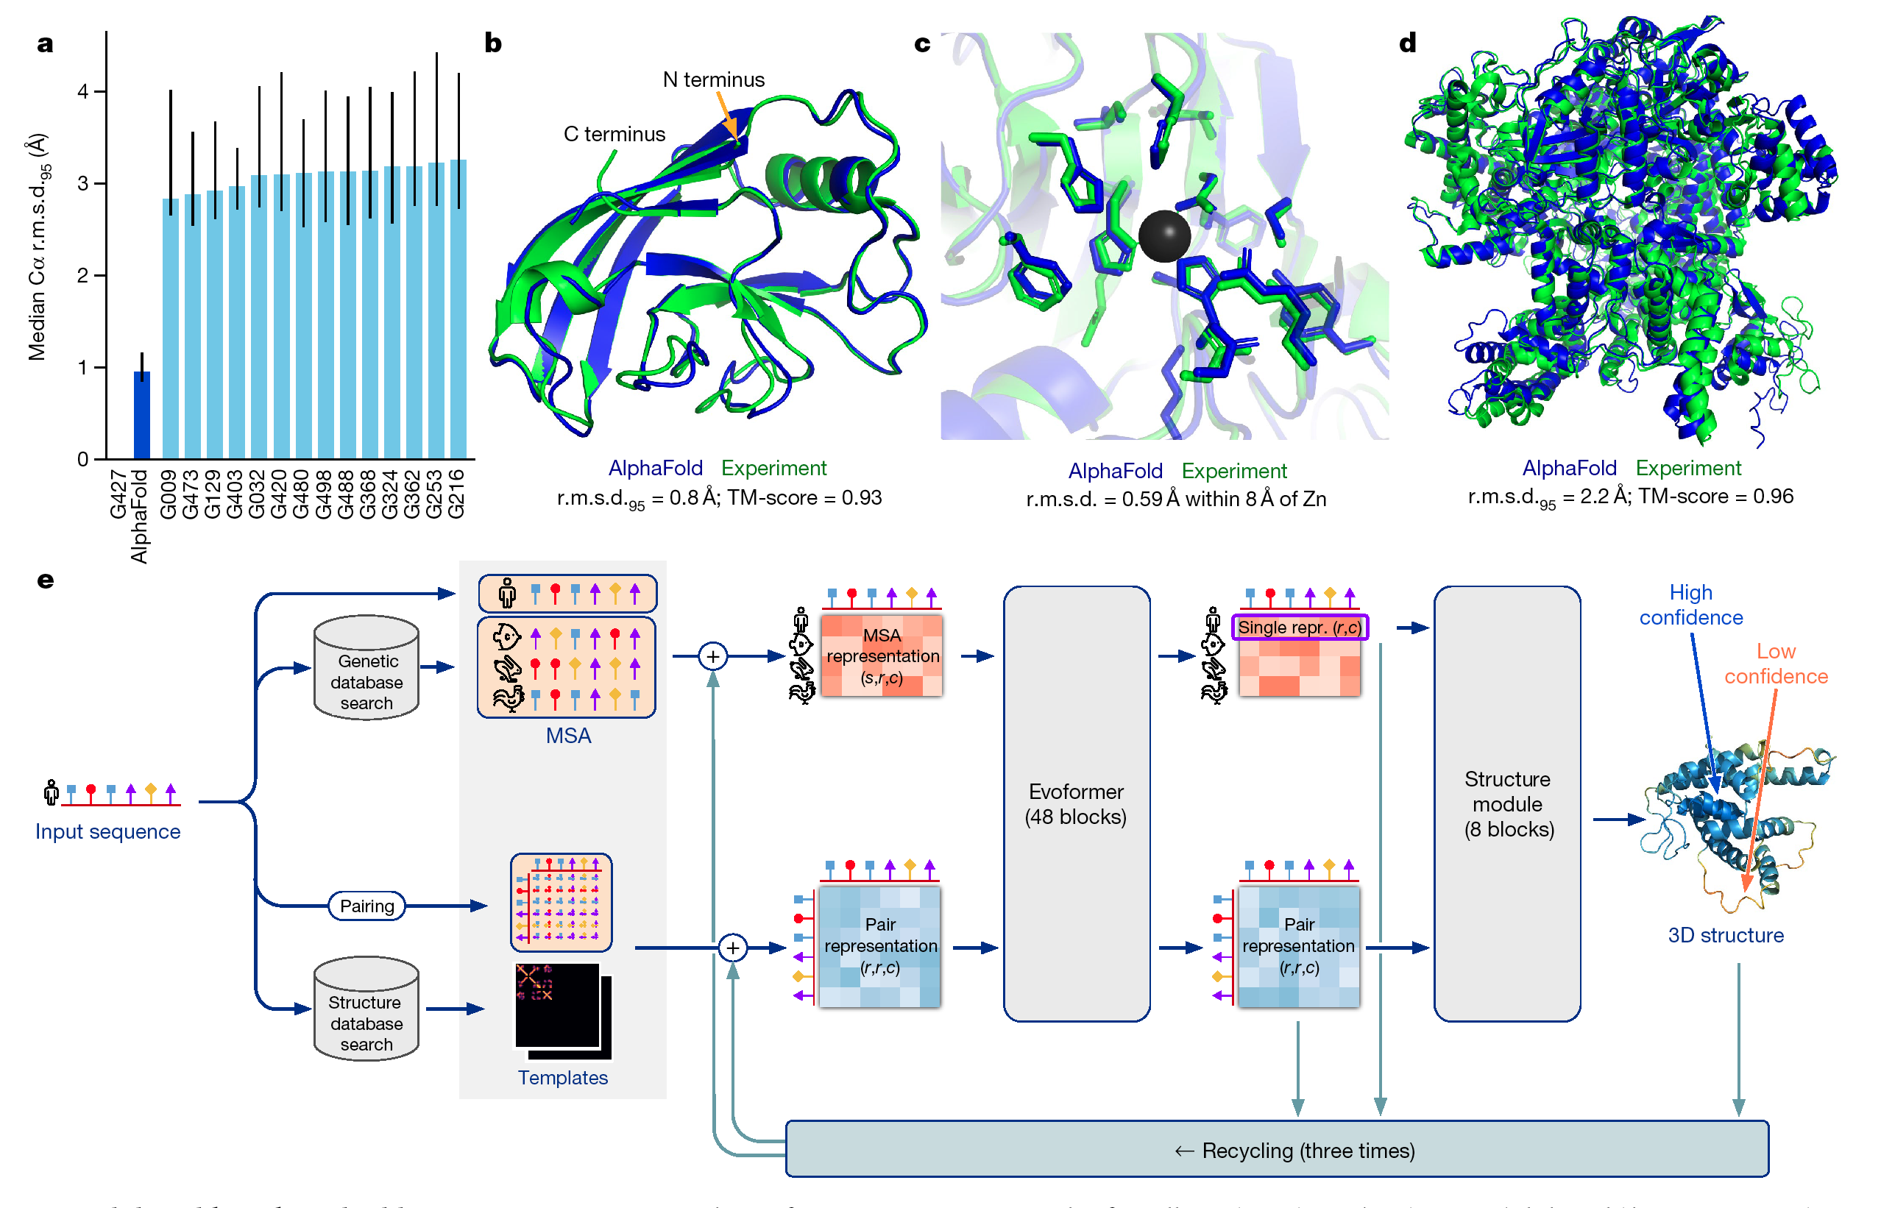
Review So Far
We used AF2 to predict protein 3D structure
Each assigned a protein from the recently assembled MPOX-22’ outbreak strain
Today we are going to analyze our predicted structures and even infer the expected function
Jumper, et. al. 2021 Nature.
https://en.wikipedia.org/wiki/Mpox
Jumper, et. al. 2021 Nature.

Slide 3
Extracting Our Output For Analysis
Our data is stored here, we need to offload it so that we can analyze it
You will download the files ranked_0.pdb, ranked_debug.json
and any file ending in the .pkl extension
You will upload the entire output folder to the class drive folder
You also must install ChimeraX for us to view the structures
Photos: GitHub HPCTraining

Slide 4
Output of AlphaFold2
https://github.com/deepmind/alphafold#alphafold-output

Slide 5
How Can We Evaluate Our Confidence In The Model?
Sequence Homology
Petti S, et. al. Bioinformatics. 2023;39(1)
THE limiting factor
sequence coverage depth
>30 sequences/residue
Typically areas of low coverage:
random disordered coils
low pLDDT
High pAE

Slide 6
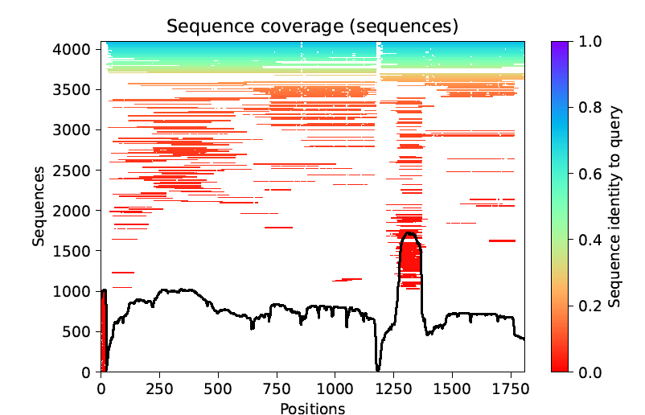
Sequence Coverage Plot
Sequence coverage plot from FLS2-BAK1-flg22 Receptor Complex - From AlphaFold 2.1.3
Color indicates how similar the protein is to our sequence
Black line shows coverage depth
(i.e. how many homologous sequences at given residue)
Each line here represents a single sequence (protein)

Slide 7
How Can We Evaluate Our Confidence In The Model?
Sequence Homology
Side-Chain C⍺ Confidence
Petti S, et. al. Bioinformatics. 2023;39(1)
Mariani V, et. al., Bioinformatics. 2013;29(21)
THE limiting factor
sequence coverage depth
>30 sequences/residue
Typically areas of low coverage:
random disordered coils
low pLDDT
High pAE
Local Distance Difference Test
3D-structure depedent
(LDDT)
R-group “feasibility”
Very High (pLDDT > 90)
Confident (90 > pLDDT < 70)
Low (70 > pLDDT > 50)
Very Low (pLDDT < 50)
*suitable for experimental design

Slide 8
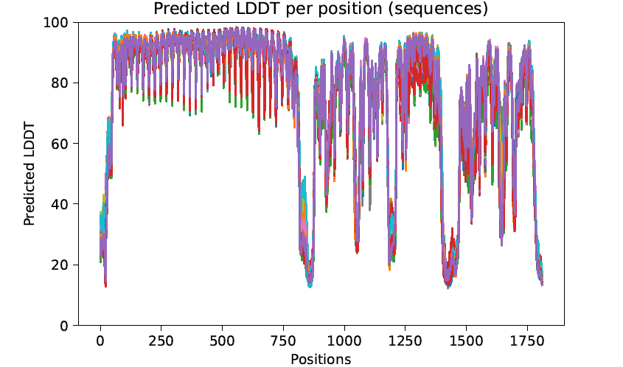
Predicted Local Distance Differance Plot
pLDDT plot for 25 models of FLS2-BAK1-flg22 Receptor Complex - From AlphaFold 2.1.3
Each line represents a different predicted model for the structure
(Your’s will only have 5)
Remember we want this value to be as >90 for experimental design

Slide 9
How Can We Evaluate Our Confidence In The Model?
Sequence Homology
Side-Chain C⍺ Confidence
Inter-domain Accuracy
Petti S, et. al. Bioinformatics. 2023;39(1)
Mariani V, et. al., Bioinformatics. 2013;29(21)
Varadi M, et. al., Nucleic Acids Res.2022;50
THE limiting factor
sequence coverage depth
>30 sequences/residue
Typically areas of low coverage:
random disordered coils
low pLDDT
High pAE
Local Distance Difference Test
3D-structure depedent
(LDDT)
R-group “feasibility”
Very High (pLDDT > 90)
Confident (90 > pLDDT < 70)
Low (70 > pLDDT > 50)
Very Low (pLDDT < 50)
Aligned Error
3D-structure indepedent
(AE)
Relative position of domains
Mutual location of domains
*suitable for experimental design

Slide 10
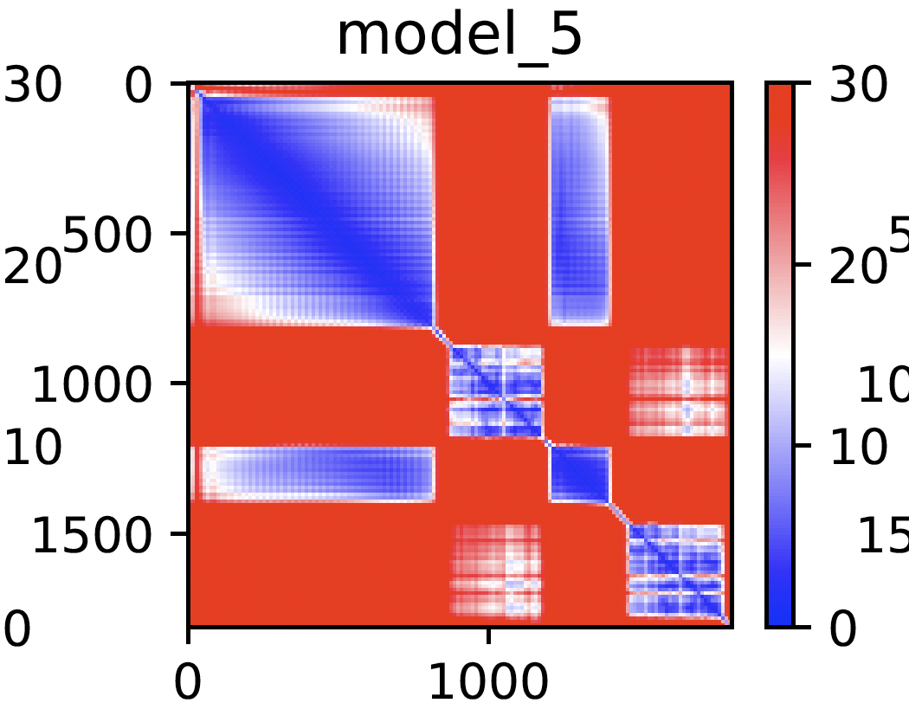
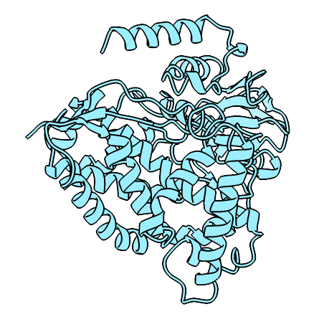
Predicted Aligned Error Plot
pAE plot for model 5 of FLS2-BAK1-flg22 Receptor Complex - From AlphaFold 2.1.3
300
Aligned Residue
Aligned Error (Å)
200
100
0
100
200
300
Scored Residue
This is the “hardest” plot to interpret and takes practice

Slide 11
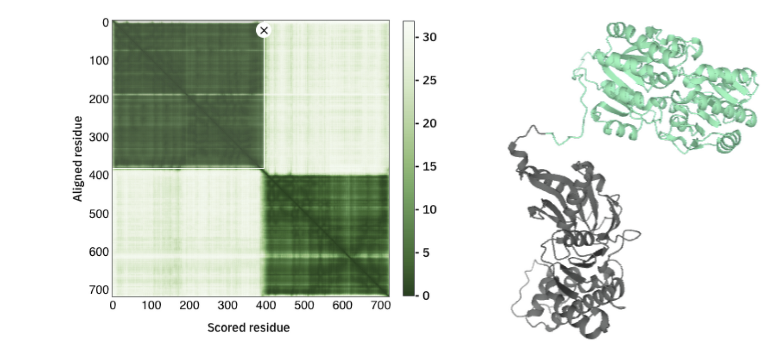
Bad PAE Example
Photo: AlphaFold2 Database, PAE Tutorial

Slide 12
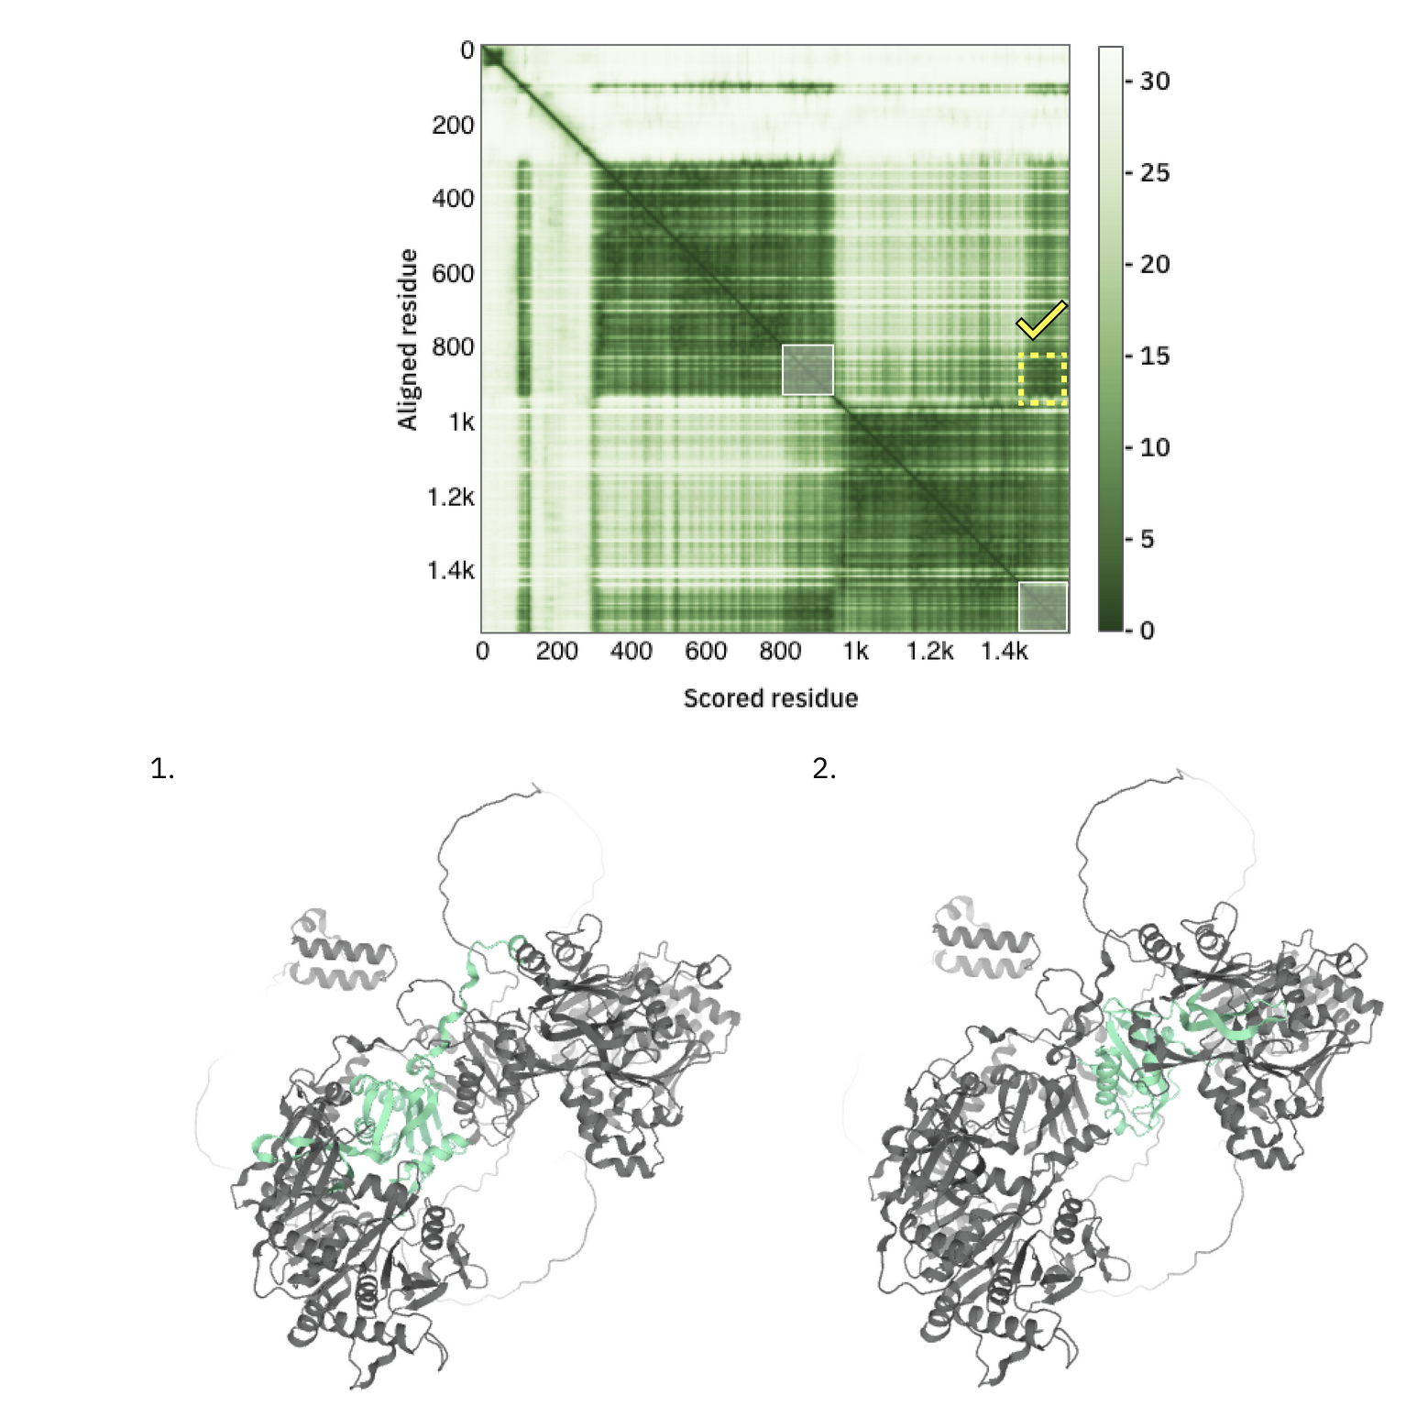
Good PAE Example
Photo: AlphaFold2 Database, PAE Tutorial

Slide 13
Using Protein Conserved Domains to Probe Function
We can leverage this classification system to probe potential function of our protein sequences.
Photos: EMBL-EBI Rescources, Protein Classification

Slide 14
Combining Predicted Structures & Conserved Domain For Sequence Annotation
So far you have….
predicted 3D structure
analyzed sequence for conserved domains
Combine all of this information
structure confidence
predicted protein function
Can you think of a way we could test our structure for cofactor/substrate binding?
Conclusions:
What metrics do we have for scoring AF2 model confidence?
pLDDT (3D structure depedent, R chain placement)
pAE (3D structure indepedent, inter-domain placement)
What situtations is AF2 evaluated for?
Single monomeric, naturally occuring protein chains
What is the largest limitation in AF2?
Homologous sequence coverage

